Slide 1
COVID DEATHS AND VACCINATIONS
File created on: 9/21/2022 3:27:18 PM

Slide 2
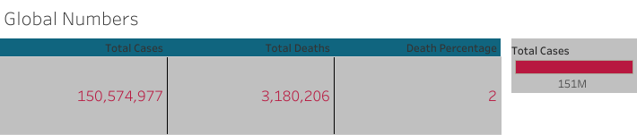

Slide 3
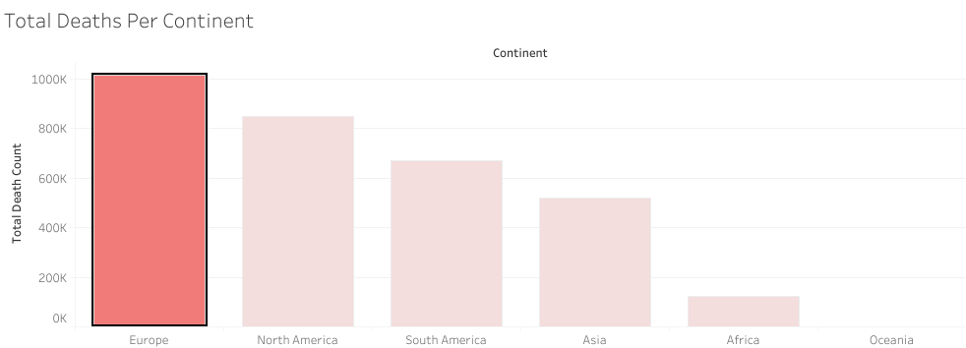

Slide 4
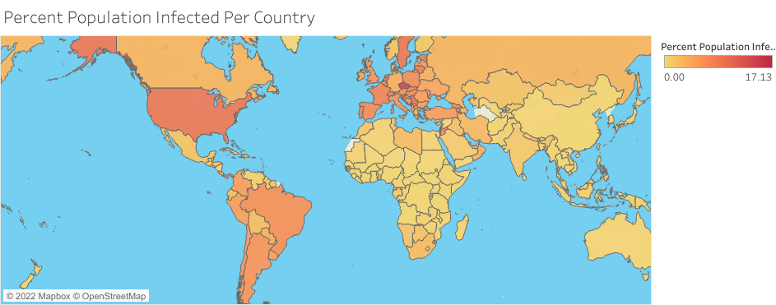

Slide 5
